Slide 1
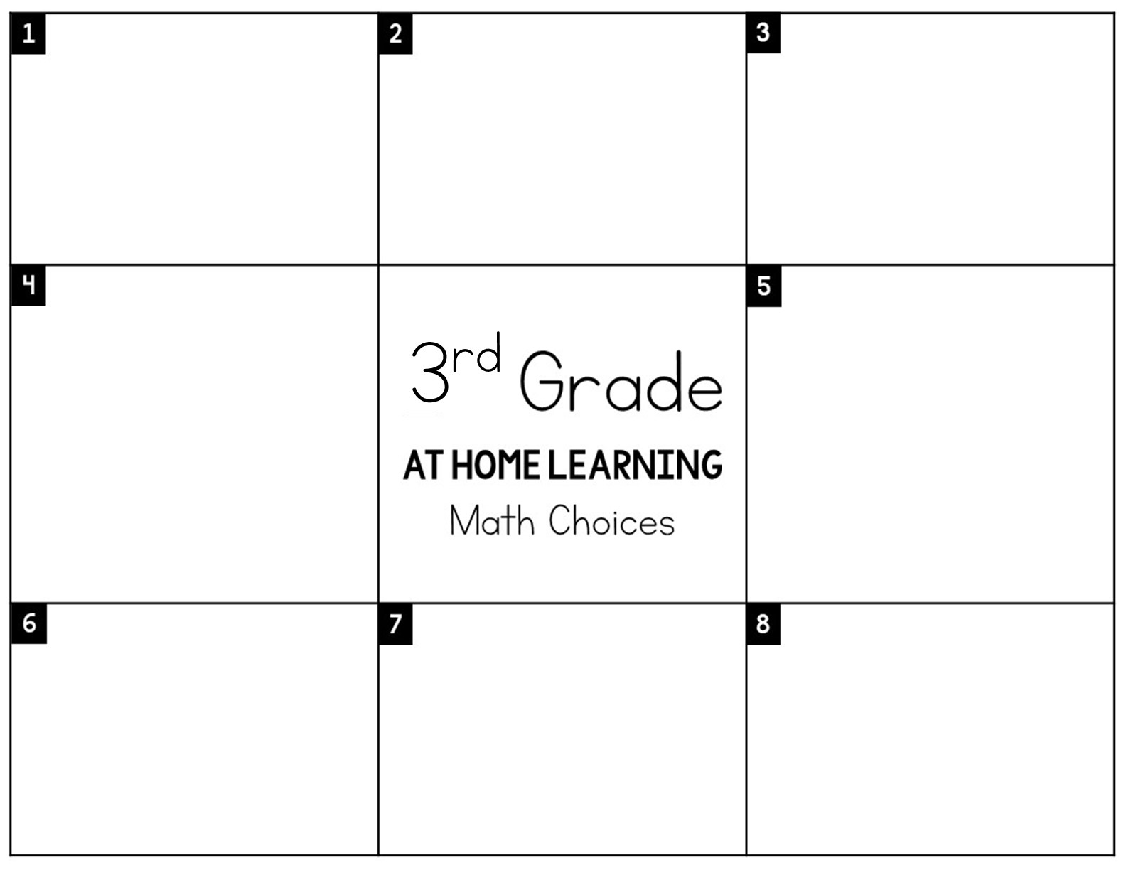
Play a math game on a computer or device for 20 minutes. Options: Dreambox, Splashmath, GoNoodle(Math)
Study your 7’s multiplication and division facts using Splashmath or Flashcards for 20 minutes.
Complete an entire Zearn lesson on Elapsed Time.
(Mission 2 Lesson 4)
Make a poster that would help students with elapsed time. Be sure to include the strategies and vocabulary we’ve learned.
Create an invitation to your birthday party. Inside include, a detailed schedule of the activities you’ll be doing. Include what time an activity starts, ends, and how long it takes. Activities can be anything you want!
Create tic tac toe game boards on paper with 7’s facts in each square. In order to take the space you have to answer the problem!
You are coaching a professional baseball team. Create their daily practice schedule. It must include: 45 minutes of batting practice, 35 minutes of fielding practice, 1 hour of weight training, 30 minutes of viewing game videos, 25 minutes of running.
Make a guide of your favorite
TV shows. Include the day,
time, show, and channel.
Record the amount of time it
takes to watch each show in a chart. Example: “Wild Kratz” 3:30-4:15 is 45 minutes.

