Slide 1
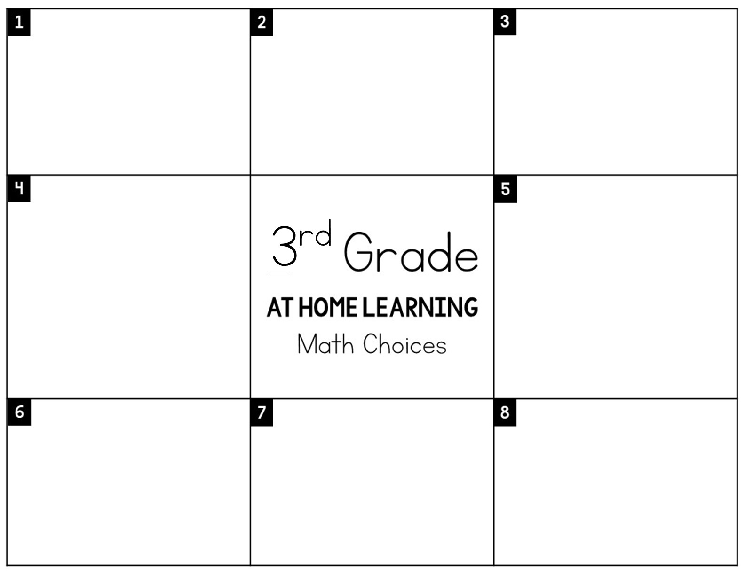
Review all of your multiplication and division facts by doing quizzes on Multiplication.com
Skip count by 2s, 5s and 10s to 300.
Challenge: Start at 450 and count by 2s to 600.
,
Think of how many family members you live with. Without going to physically count, how many total toes are there between you and your family members?
Hint: What is the best operation to use to solve this problem?
Challenge someone in your home to see who can complete the most hops on one foot. How many more hops did the winner complete than the loser?
Write all the numbers between 1,056-1,095. Pick two numbers and add or subtract them. Show your work for the strategy used to solve.
.
Pretend you are planning our end of the year class party and you have $200 to spend. Create a budget for
how your money will be spent.
Set a timer for 5 minutes. Have a family member use flashcards to test you on ALL facts. Try and get as many correct as you can!
Create your own math problem using objects and family members in your house. Share it with someone and see if they can solve it!

